Slide 1

Professional Development

Slide 2
Questpro is a national, full-service recruiting firm focused solely on the Insurance and Risk Management industry. For over 23 years we have made companies better by placing great people.

Slide 3
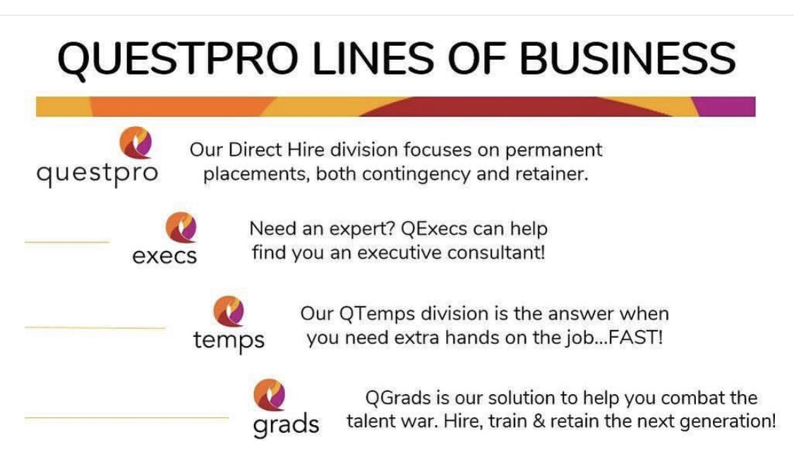


We have four divisions:

Slide 4
Social Media
AKA Personal Branding

Slide 5


How to be a LinkedIn Pro
10 tips when using LinkedIn
Keep work history relevant
Share industry related content
Professional photo
Make your profile searchable with keywords
Add visuals
Use actual numbers and stats when you are able
Connect with recruiters and industry professionals
Use skill endorsements
Join groups and events that are related to your area of expertise
Summary should focus on all major achievements from relevant job experience
OTHER SOCIAL MEDIA TIPS
Just because your profile is private…doesn’t mean companies can’t find you.
Be cautious and aware of any content you share that may be controversial.

Slide 6
Job Search
Here’s where to look…

Slide 7
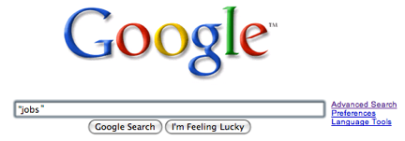

The Where & The How
Utilize Job Search sites: LinkedIn, CareerBuilder, Indeed, Monster, Simply Hired, NIRA, Great Insurance Jobs, Great Insurance Recruiters, SOA job board, etc.
Make sure that if you use an “upload resume” function that it formats your resume correctly…if not, DO IT MANUALLY.
Don’t forget your contact information and phone number!

Slide 8

What are you looking for?
FCAS vs. FSA?
Location?
Full-time or Internship?
Actuary or not?

Slide 9
What are you still learning?
Exams
Actuarial software
Programming languages
Data science

Slide 10

Interviewing Skills

Slide 11
Interview Tips
Goals of the interview
Ask Questions
Market Yourself
Provide Examples
Be enthusiastic and passionate about presenting yourself
Present your qualifications and always use examples to support what you say
Learn as much about the company and the position as you can during the process
Prepare specific examples of your experiences, accomplishments and personal skills
Prepare questions that:
Help you understand the company’s history, mission, values
Help you understand the job’s responsibilities
Give you insight into future growth
After the interview
Send “thank you” follow-up emails within 24 hours
If you are excited and interested in the position, let them know!
Ask them what next steps are!
Preparing for the Interview
Research the company and learn more about:
The company's business
Mission/vision/history
Available bios about the people you will be meeting with (or use linkedin.com!)
Emphasize most relevant skills and experiences!

Slide 12

Networking

Slide 13





How to Network
Professional Organizations: GIS, SOA, CAS, RIMS, CPCU, YRP (Young Risk Professionals), YA (Young Agents)
Keep it to 1-2 drinks
Make NEW connections
Secure your elevator speech and prepare questions
Ask for introductions
Put down the phone and any other distractions
Ask for business cards and bring a resume if it’s
appropriate
Follow up in a timely manner

